Slide 1

WEB DEVELOPMENT II
Introduction to MySQL

Slide 2

What is a database?
A database is a way of storing data.
Databases are specifically designed to be very efficient in storing and retrieving data.
The most common way of structuring data in a database is relational database system

Slide 3
Relational databases
A relational database is a structured collection of tables.
Each table consists of rows called records.
Columns of the table have keys called fields. Each cell contains data.
Most tables have a special column that identifies the rows of the table. The values in this column are called primary keys.

Slide 4
What is SQL?
SQL stands for Structured Query Language.
It is a standard language developed for accessing and modifying relational databases.
SQL in turn is used by a database management system. Some common database management systems are:
MySQL
SQLite
PostgreSQL
Oracle
Microsoft SQL Server

Slide 5
MySQL
MySQL is free.
Very widely used.
Implements SQL database mangement.
Linux Red Hat already includes MySQL.
Facebook uses MySQL

Slide 6
MySQL from the CLI
First we login to the MySQL system. From your CLI type:
mysql -u yourlogin -p
-u specifies that you are giving a login.
-p specifies that your login requires a password.

Slide 7
Basic MySQL commands
MySQL is case insensitive although field names are case sensitive.
MySQL commands end in a ; so if you do not end your command with a ; MySQL assumes you want to keep typing

Slide 8
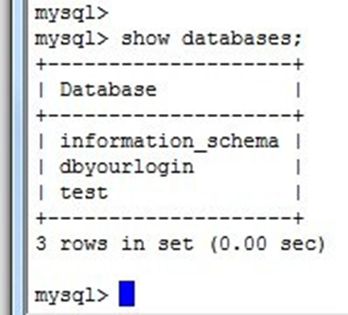
show databases
You can see which databases your account has access to by entering the SQL command
SHOW DATABASES;

Slide 9
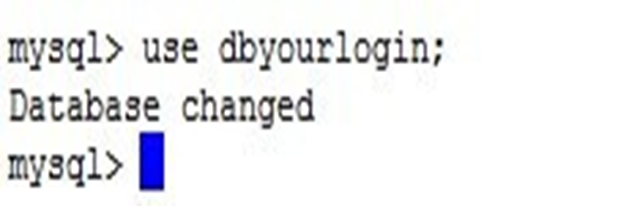
USE databasename;
You can select a database to use by entering the SQL command:
USE databasename;

Slide 10
SHOW TABLES;
SHOW TABLES; can be used to see all the current tables in your database.

Slide 11
SQL
At the MySQL prompt we can write in SQL instructions.
We will now learn more about the basic SQL commands

Slide 12
CREATE TABLE
To create a new table we use the CREATE TABLE command. Syntax for creating a new table is:
CREATE TABLE IF NOT EXISTS tablename (
fieldname1 type options default 'defaultvalue', fieldname2 type options default 'defaultvalue',
...
);
There are number of possibilities for type including: varchar (or char) int, float(significant digits, digits after decimal).
After specifying type, you may specify the max length of the variable. eg. varchar(10)

Slide 13
Example
CREATE TABLE IF NOT EXISTS students (
name varchar(100), sid int(9),
gpa decimal(3,1), phone varchar(12)
);

Slide 14
SELECT
Is used to ask for data from a table.
It tells the database to retrieve info from any number of tables and return it as a result set.
Syntax:
SELECT [fields here] FROM [tables here];
SELECT [fields here] FROM [tables here] WHERE [condition here];

Slide 15
Example
Show all records from table "students" where the field called "name" has the value "Joe".
SELECT * FROM students WHERE name = "Joe";
Show all records from table "people" where the field called "name" has the value "Joe" AND the phone number "555- 6789".
SELECT * FROM people WHERE name = "Joe" AND phone_number = "555-6789";

Slide 16
Example
Show all records from table "students" where the field called "name" has the value "Joe" OR "Bob".
SELECT * FROM students WHERE name = "Joe" OR name = "Bob";
Show "student_id" and "name" fields from table "students" with GPA greater than or equal to 3.5.
SELECT sid, name FROM students WHERE GPA >= 3.5;

Slide 17
INSERT
Add a record to a table in a database. Syntax:
INSERT INTO tablename (field1, field2, ...)
VALUES ('val1', 'val2', ...);
Example:
INSERT INTO students (name,sid,gpa,phone) VALUES ('Zoidberg',77843211, -4.0,"N/A");

Slide 18
UPDATE
Modify an existing record in the database Syntax:
UPDATE tablename SET fieldname = value WHERE
condition;
Example:
UPDATE students SET GPA ='3.8' WHERE person = 'Joe';

Slide 19
DELETE
Removes an existing record in a database Syntax:
DELETE FROM tablename WHERE condition;
Example:
DELETE FROM students WHERE name="Fry";

